Slide 1


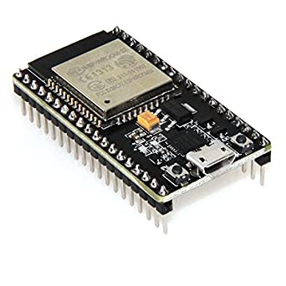
IPFS
 |  | IPTABLE
NAME | IP | BROKER? (=1) | IPFS/IPNS HASH
Sensor1 | 1.1.1.57 | 1 | QmarHSr9aSNaPSR6G9KFPbuLV9aEqJfTk1y9B8pdwqK4Rq
Sensor1
BROKER

Slide 2
IPFS
 |  |  | IPTABLE
NAME | IP | BROKER? (=1) | IPFS/IPNS HASH
Sensor1 | 1.1.1.57 | 1 | QmarHSr9aSNaPSR6G9KFPbuLV9aEqJfTk1y9B8pdwqK4Rq
Sensor2 | 1.1.1.25 | 0 | QmarHSr9aSNaPSR6G9KFPbuLV9aEqJfTk1y9B8pdwqK4Rq
Sensor2
send
Sensor1
BROKER

Slide 3
IPFS
 |  |  | IPTABLE
NAME | IP | BROKER? (=1) | IPFS/IPNS HASH
Sensor1 | 1.1.1.57 | 1 | QmarHSr9aSNaPSR6G9KFPbuLV9aEqJfTk1y9B8pdwqK4Rq
Sensor2 | 1.1.1.25 | 0 | QmarHSr9aSNaPSR6G9KFPbuLV9aEqJfTk1y9B8pdwqK4Rq
Sensor3 | 1.1.1.83 | 0 | QmarHSr9aSNaPSR6G9KFPbuLV9aEqJfTk1y9B8pdwqK4Rq
Sensor2
updateIPTables
Sensor1
BROKER
Sensor3

Slide 4

IPFS
 |  |  | IPTABLE
NAME | IP | BROKER? (=1) | IPFS/IPNS HASH
Sensor1 | 1.1.1.57 | 0 | QmarHSr9aSNaPSR6G9KFPbuLV9aEqJfTk1y9B8pdwqK4Rq
Sensor2 | 1.1.1.25 | 1 | QmarHSr9aSNaPSR6G9KFPbuLV9aEqJfTk1y9B8pdwqK4Rq
Sensor3 | 1.1.1.83 | 0 | QmarHSr9aSNaPSR6G9KFPbuLV9aEqJfTk1y9B8pdwqK4Rq
BROKER
Sensor2
Node with lowest IP-Adress is the new Broker
Sensor1
updateIPTables
Broker lost connection
Sensor3

Slide 5
IPFS
 |  |  | IPTABLE
NAME | IP | BROKER? (=1) | IPFS/IPNS HASH
Sensor1 | 1.1.1.57 | 0 | QmarHSr9aSNaPSR6G9KFPbuLV9aEqJfTk1y9B8pdwqK4Rq
Sensor2 | 1.1.1.25 | 1 | QmarHSr9aSNaPSR6G9KFPbuLV9aEqJfTk1y9B8pdwqK4Rq
Sensor3 | 1.1.1.83 | 0 | QmarHSr9aSNaPSR6G9KFPbuLV9aEqJfTk1y9B8pdwqK4Rq
BROKER
Sensor2
Sensor1
updateIPTables
Sensor3

